Slide 1

A PROJECT PRESENTATION ON
“Rent-A-Style An E-Commerce Renting Website”
PRESENTED BY
Aman Agham
Anvesh Modak

Slide 2
1.INTRODUCTION
Whenever we need something that we don't have, we go to a store and purchase it. But sometimes, even in the store those items are not available, Other options such as supermarkets or malls exist. But its not always accessible to go to a place to get things, hence shopping online is very convenient.
This project "E- Store" is an effort to cater the people by providing them with products of various varieties. From your daily need things to thing you need for your home, all in one place.
From a customer’s point of view, they can browse through a catalogue of products, search for products, add products to their cart and place orders. Customers can even create an account and add addresses. They can easily browse products via category feature. register their account login to their account, update their account, delete their account
From the admin’s point of view, the admin can view seller details, customer details, order details and can also delete customer and seller accounts if needed. register their account login to their account, update their account, delete their account
From the seller’s point of view, they can add a product, update the product, new sellers can register their account, login to their account, update their account details and delete their account.

Slide 3
2. PRODUCT OVERVIEW AND SUMMARY
2.1. PURPOSE
“Rent-A-Style”, is a web-based online e-commerce rental webapp which aims to provide users with an easy to navigate and visually appealing medium to browse through a catalogue of products and shop for the products they desire
2.2. SCOPE
“Rent-A-Style”, aims to deliver a web-based rental application that hosts a wide collection of products that users can browse through. Sellers can add products to cart and place orders for each product. They can update their profile, update profile, view cart and place orders.
They can view their current order as well. Seller can manage various product details like price, adding new products, updating existing products etc.
E-Store is only an interface for both customers (for browsing and shopping for products) and sellers (for managing products).

Slide 4
2.3. OVERVIEW
A.TECHNOLOGIES USED
FRONT END
Bootstrap
React
BACK END
Spring Boot
DATABASE MANAGEMENT SYSTEM
mySQL

Slide 5
B.FEATURES PROVIDED
FOR CUSTOMERS
Browse – Customers can browse the homepage to explore the entire collection of products available, as well as view details for individual products.
View– When a customer checks product details, they can also view the details.
Register, Login & Logout – New customers can register on the site. Existing customers can then login to access their account information and logout when the account is not in use.
View & Update Profile – When logged in, customers can view their profile and update their details.
Add to Cart & Place Orders – If customers find products that they like, they can save the products in the cart until they decide to purchase it. When they wish to purchase it, they can place orders for those products by selecting a delivery address.
View Order Details – Every customer can view their order history in order to get an idea about their past spendings and how much they saved on each order.

Slide 6
FOR SELLER
Register, Login & Logout – Similar to customers, sellers can register their account, login & logout to access their account.
Delete Product –The seller can delete a product if they need to for any purpose.
Add New products – Seller can add new products with all the necessary details like product name, brand, category, price, etc
Update product Details – Often, the details of a product such as the price, may change over time. In such cases, the seller can update those product details to reflect the change on the application.

Slide 7
FOR ADMIN
Login & Logout – Similarly admin can login & logout to access their account.
Delete customer and seller – The admin can delete a customer or seller if they need to for any purpose.
Admin can also view order history.
Admin can also update details like password

Slide 8
2.2. FEASIBILITY STUDY
Feasibility is the determination of whether a project is worth undertaking or not. Before actually recommending the new system, it is important to investigate if it is feasible to develop it. Before developing and implementing a system, we have to make sure that the system is feasible in the following ways:
A.TECHNOLOGIES USED
In this type of feasibility study, the system analyst has to check whether it is possible or not to develop the requested system with the available manpower, software, hardware, etc.
This project makes use of cross-platform software and solutions like Java, and hence can run on any operating system. React, used in front-end, is swift and light weight framework when it comes to delivering the requested page as it doesn’t reload the entire page for every HTTP request. It only re-renders the components that need to fetch new data. Also, as React is modular in nature, it is easy to develop new components and scale up existing components in order to add new features to the system.
The combination of Spring Boot for backend makes for a fast, easy to set-up and reliable system to interact with the database, as they are secure and transactional in nature. Since the sensitive data of customers and admins need to be stored in a robust and secure database, MySQL database management system was chosen as it is an industry standard.

Slide 9
B.OPERATIONAL FEASIBILITY
In this type of feasibility study, the operation of the system is considered. An analysis is performed on whether it is feasible for the user department to use the application. Thus, the proposed system is said to be operationally feasible only if clients are able to understand the system clearly and correctly, and can use it with ease.
In the design of this project, we always kept user experience in mind. We made an effort to have a good user interface with consistent theme and alluring design to keep the users interested and engaged.
In our project, the use of universally known icons and instructions that are easy to understand makes sure that the user will not need any special technical know-how to use the application.
We made sure that the information available throughout the application is arranged in a logically coherent and consistent manner, guaranteeing that the users will have a smooth and effortless experience and even enjoy using the application.
C.ECONOMIC FEASIBILITY
In this type of feasibility study, the benefits of the system to the organization are considered by taking into consideration the cost-benefit analysis. All the software and technologies used in our project free, open-source, and widely available, with each of the technologies having an extensive community support. This makes “E-Store” an economically feasible solution to the organizations that wish to implement it

Slide 10
3.REQUIREMENTS FULFILLED
3.1 FUNCTIONAL REQUIREMENTS
➢ Customers can browse through all available products.
➢ Customers can place orders for products and view their order history.
➢ Sellers can manage various product details like product price, adding new products, etc.
➢ Sellers can update the product details.
➢ Sellers can update their account details and delete their account if needed.
➢ Admins can delete customers and sellers if the need arises.
➢ Admins can view all the orders placed by the customers.

Slide 11
3.REQUIREMENTS FULFILLED
3.2 NON-FUNCTIONAL REQUIREMENTS
➢ Since the application uses lightweight and established software components that are also cross-platform, it is remarkably performant and has good support for every operating system.
➢ The use of React for front end and Spring Boot for back end delivers quick response times to admins and customers alike.
➢ Card-style UI and well-known icons and symbols used throughout the application provides a consistent theme and user-friendly interface that anyone can grasp easily, even without a technical background

Slide 12
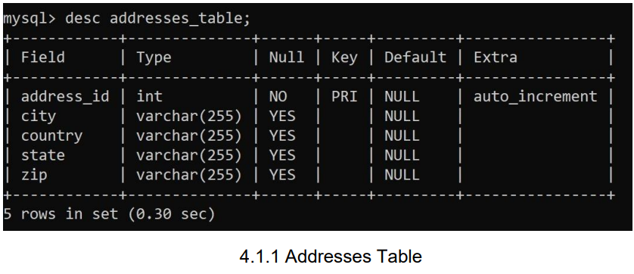
4. PROJECT DESIGN
4.1.DATA MODEL
❖ Tables Related to User Details

Slide 13
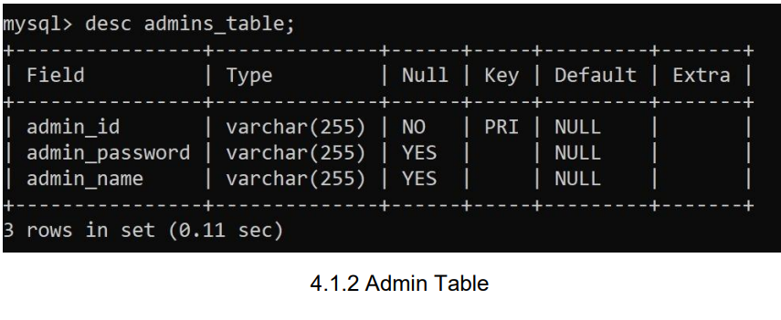
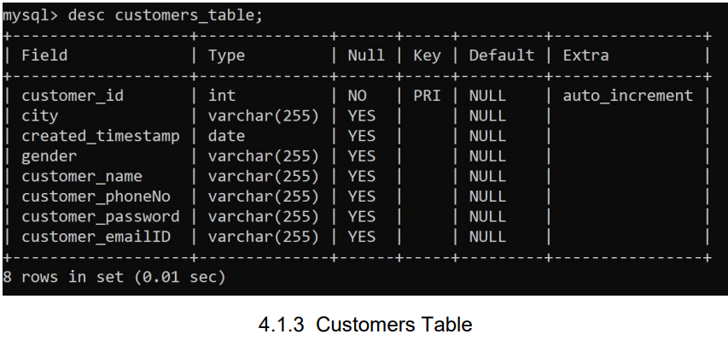

Slide 14
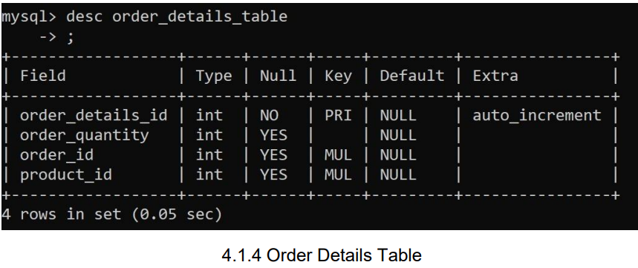
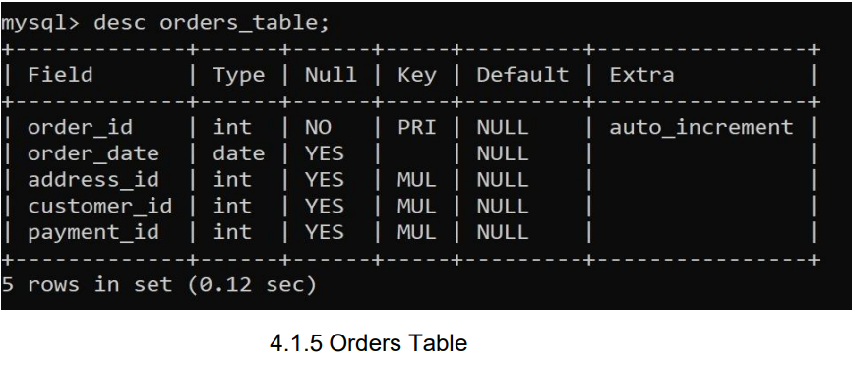

Slide 15
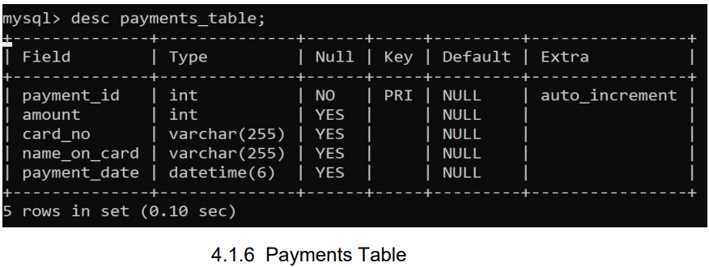
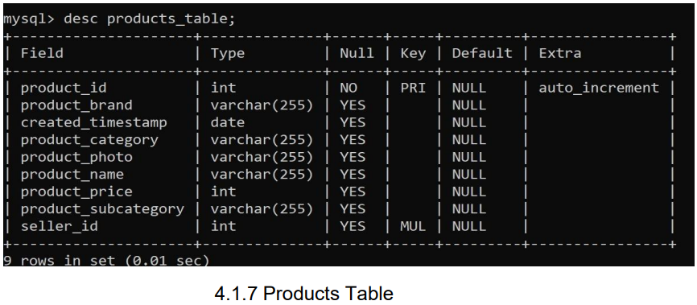

Slide 16
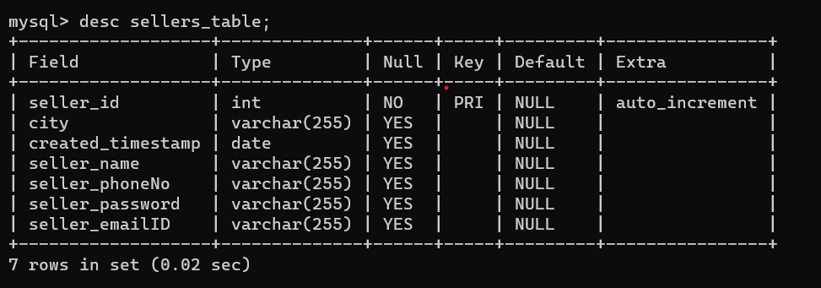

Slide 17
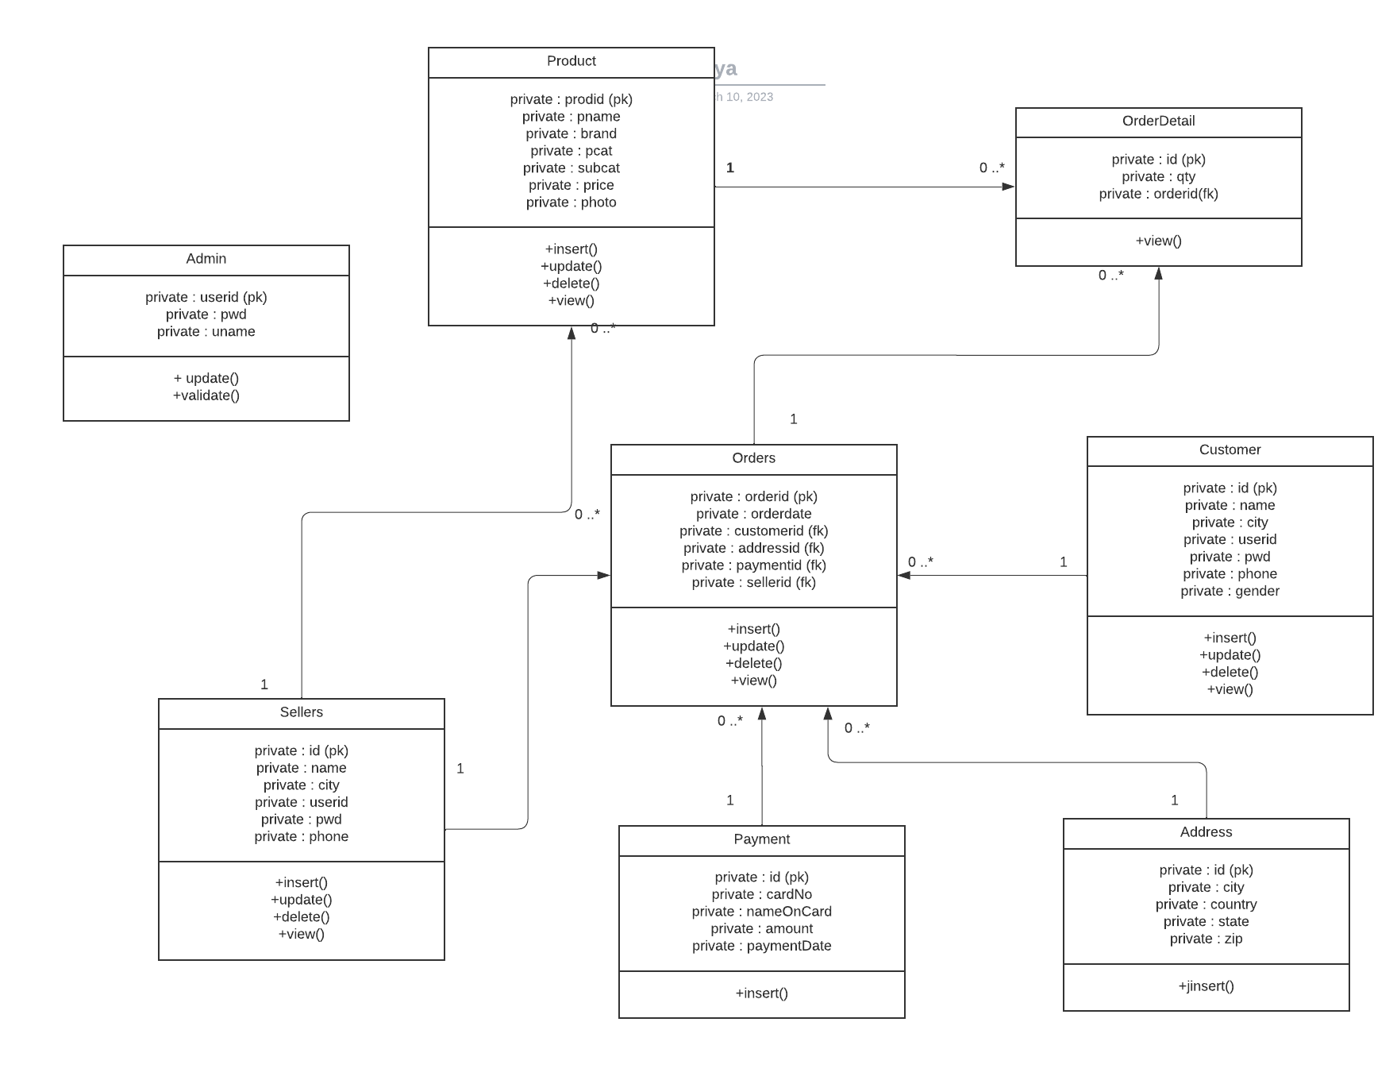
4.3. CLASS DIAGRAM

Slide 18
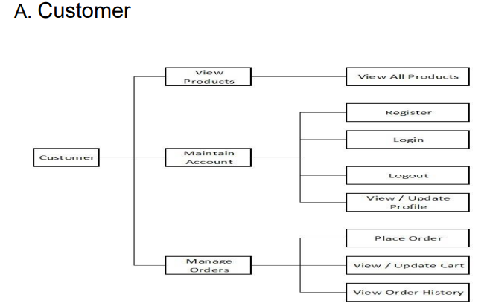
4.3.USE CASE DIAGRAM

Slide 19
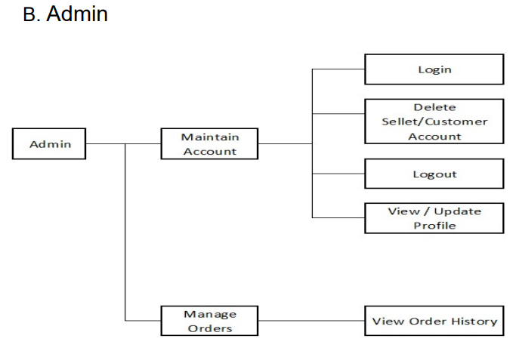

Slide 20
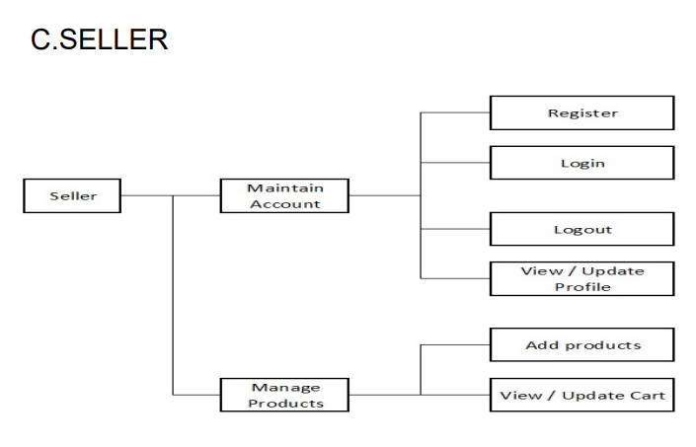

Slide 21
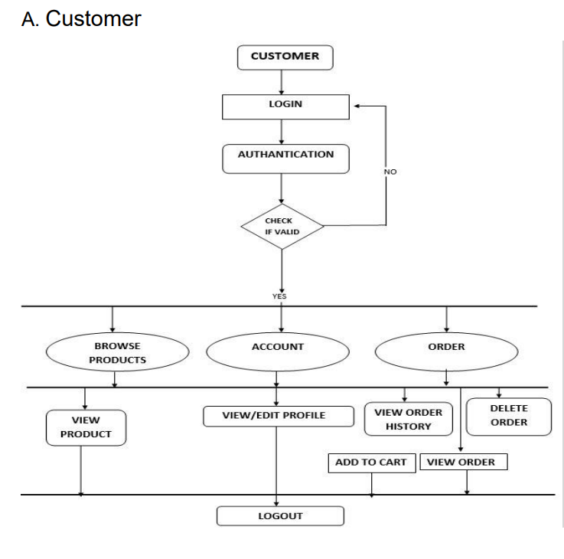
4.4.ACTIVITY DIAGRAM

Slide 22
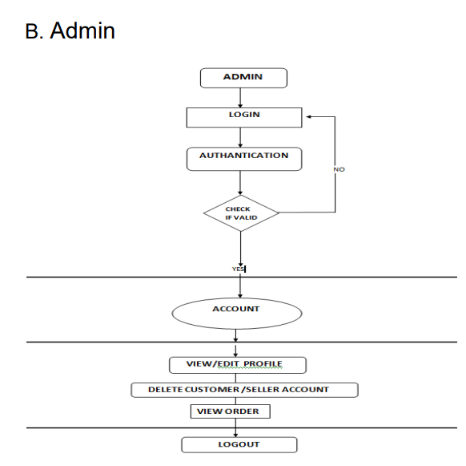

Slide 23
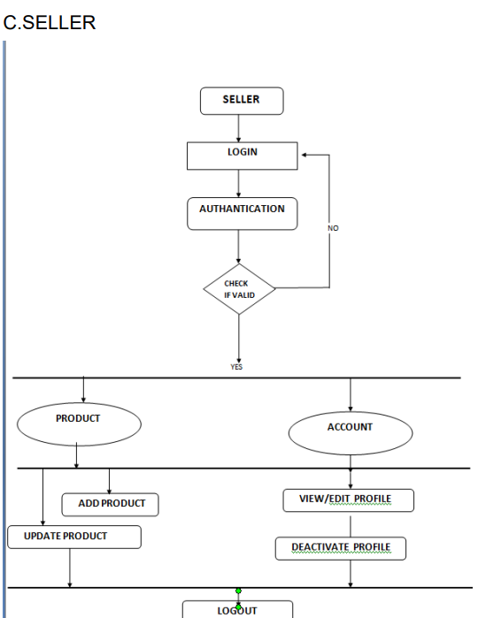

Slide 24
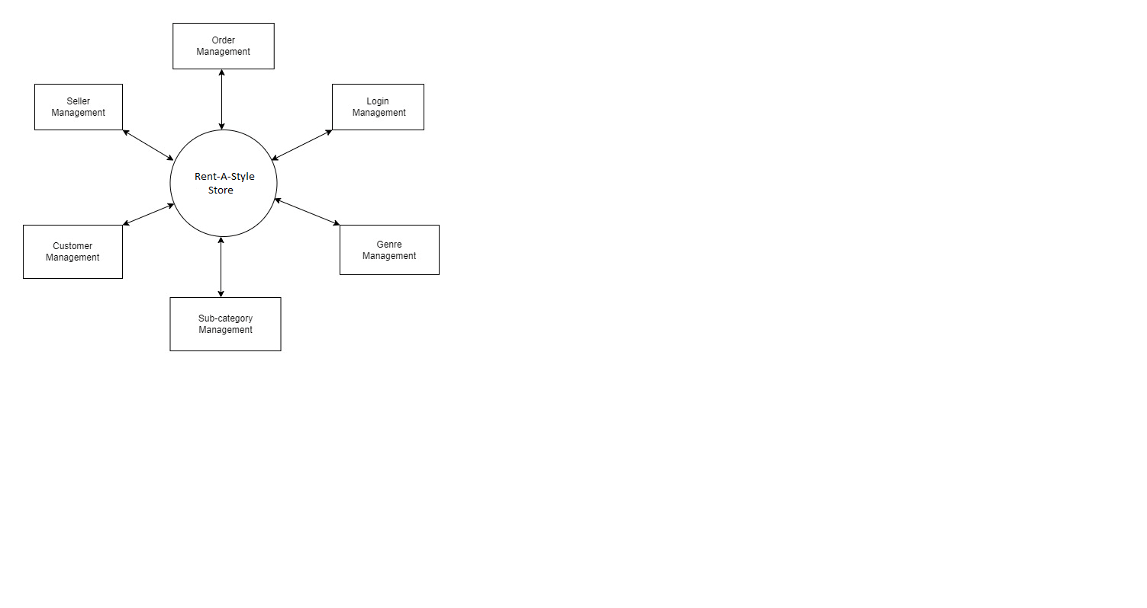
4.5. DFD

Slide 25
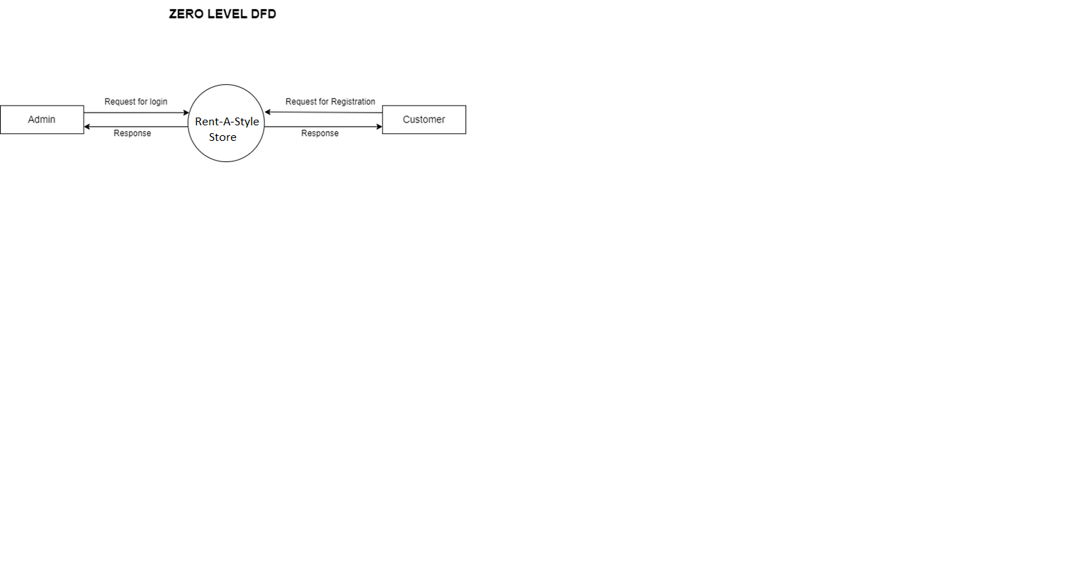
4.5. Zero level DFD

Slide 26
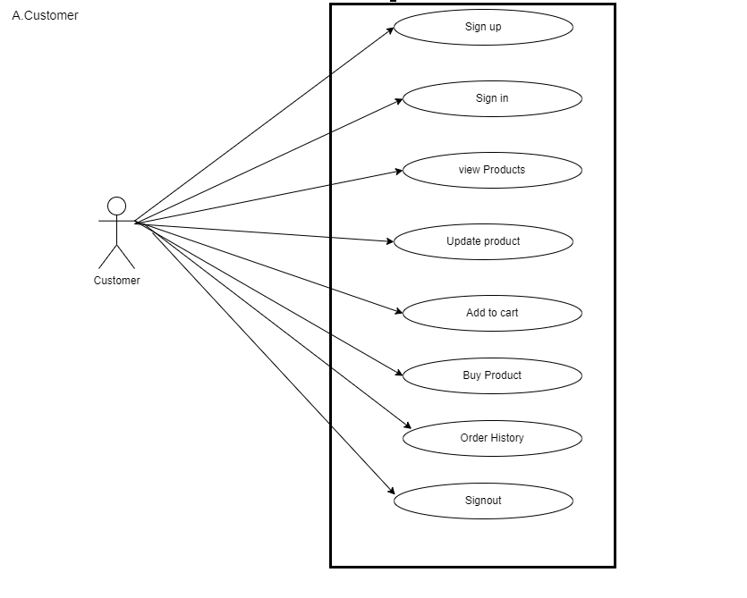
4.6. UML (Customer)

Slide 27
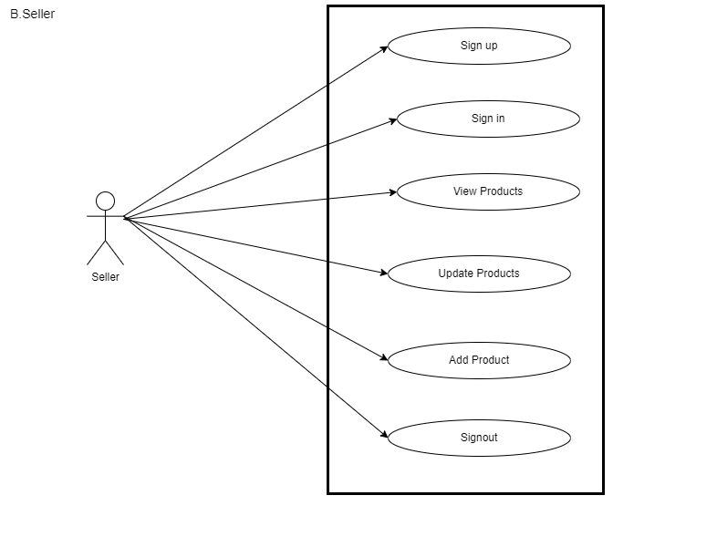
4.6. UML (Seller)

Slide 28
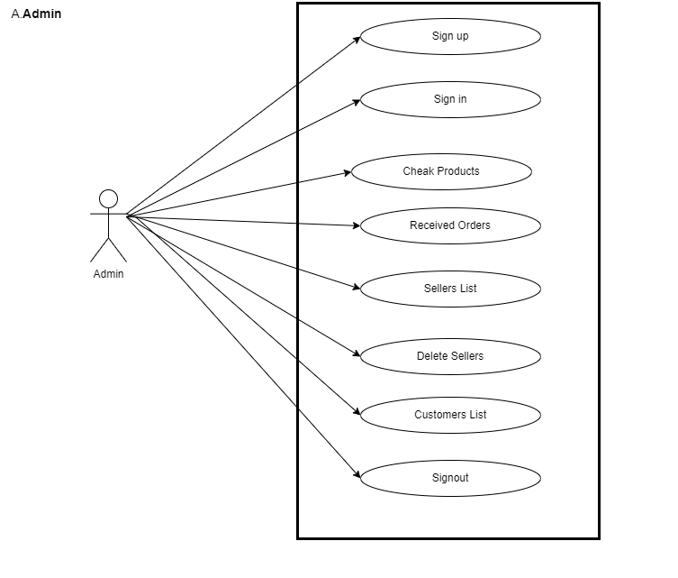
4.6. UML (Admin)

Slide 29
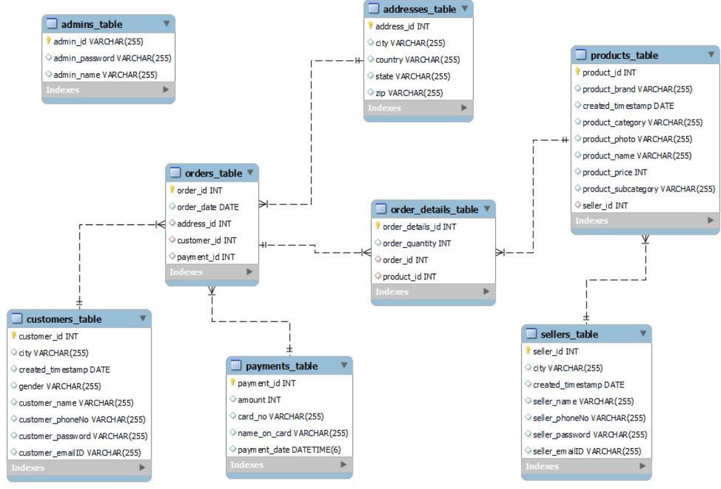
4.6. ER DIAGRAM

Slide 30
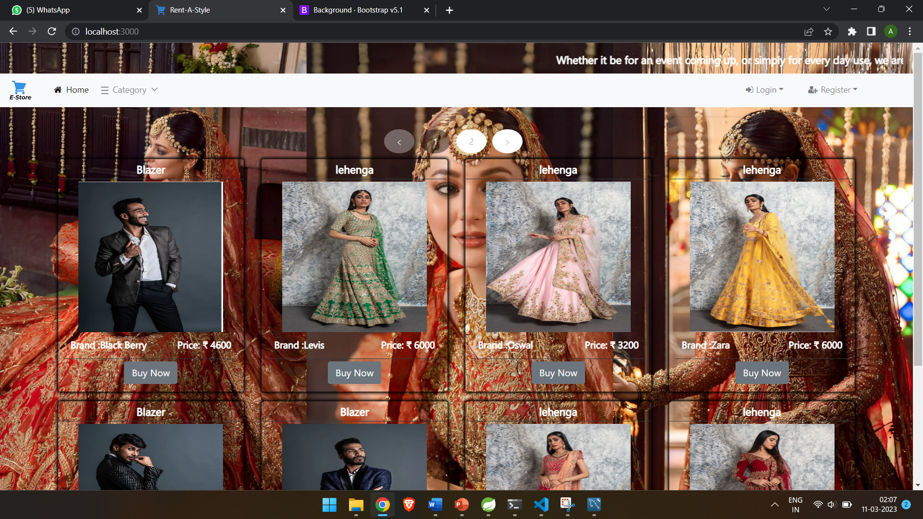
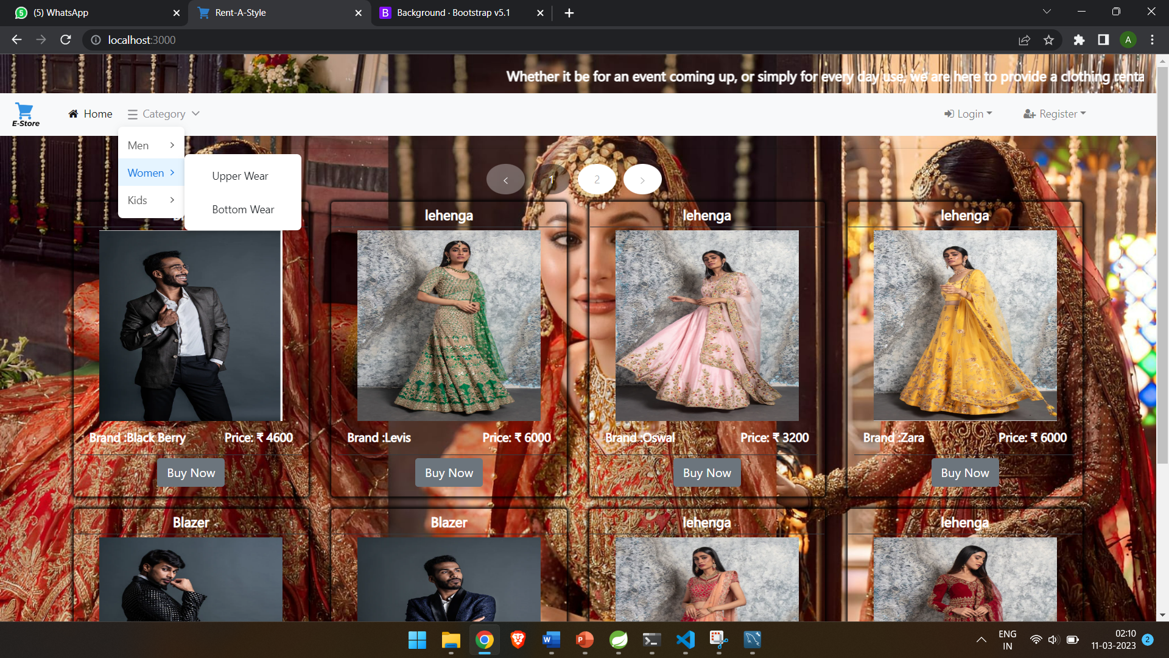
5. PROJECT SCREENSHOTS
5.1. HOME

Slide 31
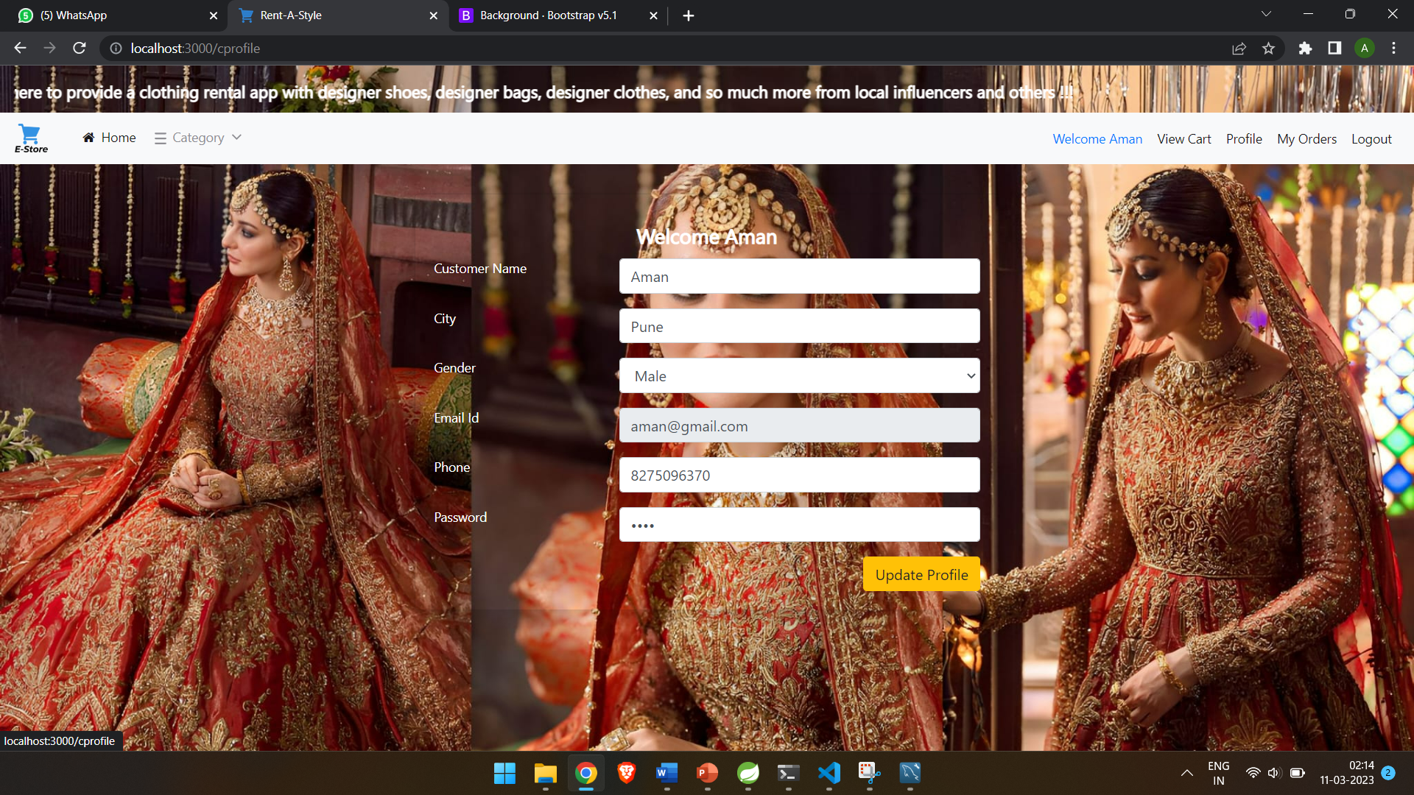
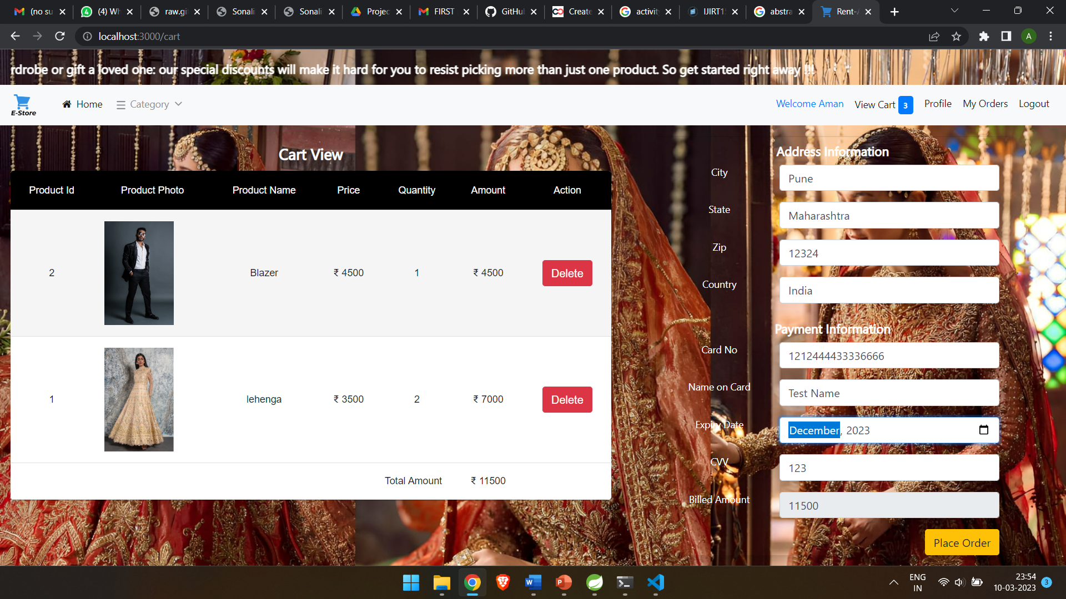
5.2. CUSTOMER

Slide 32
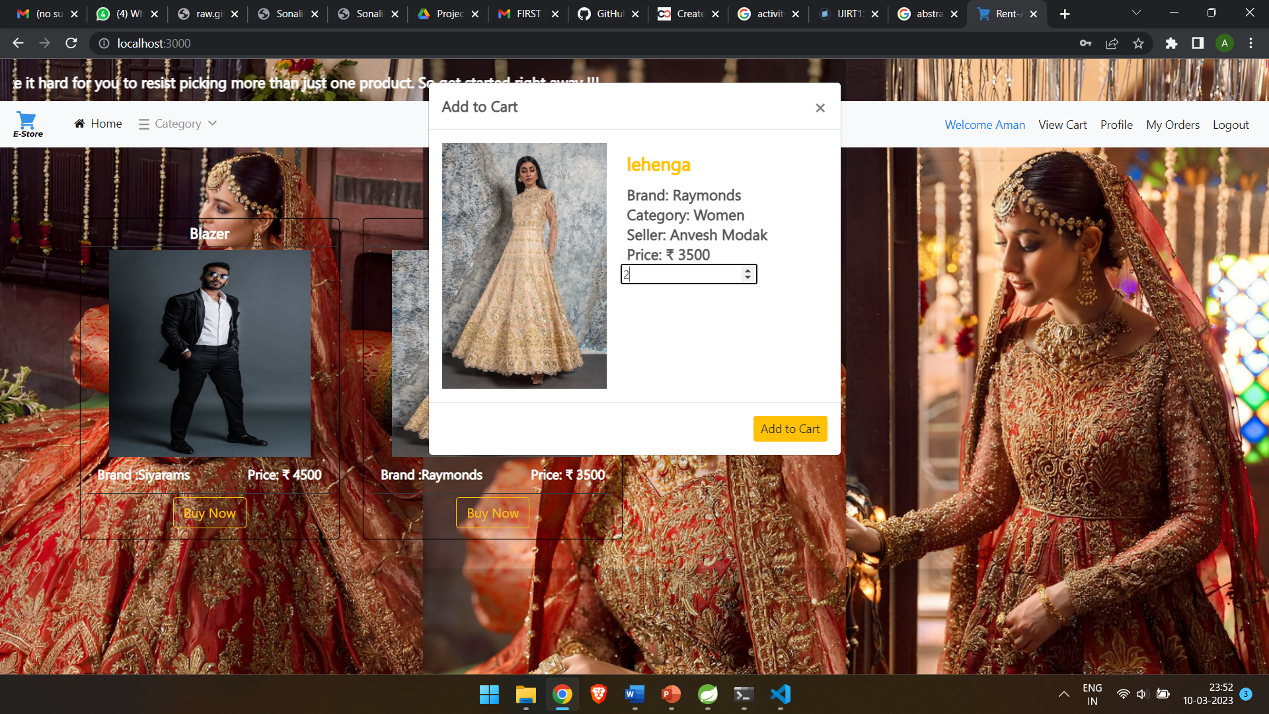
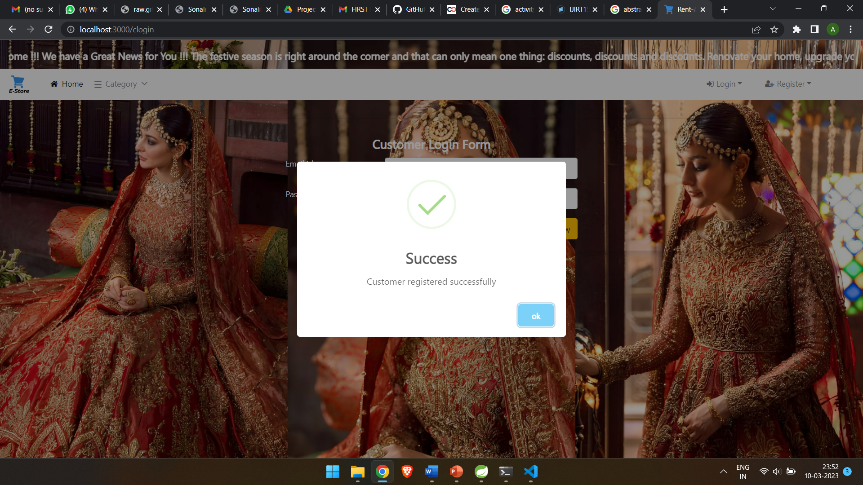

Slide 33
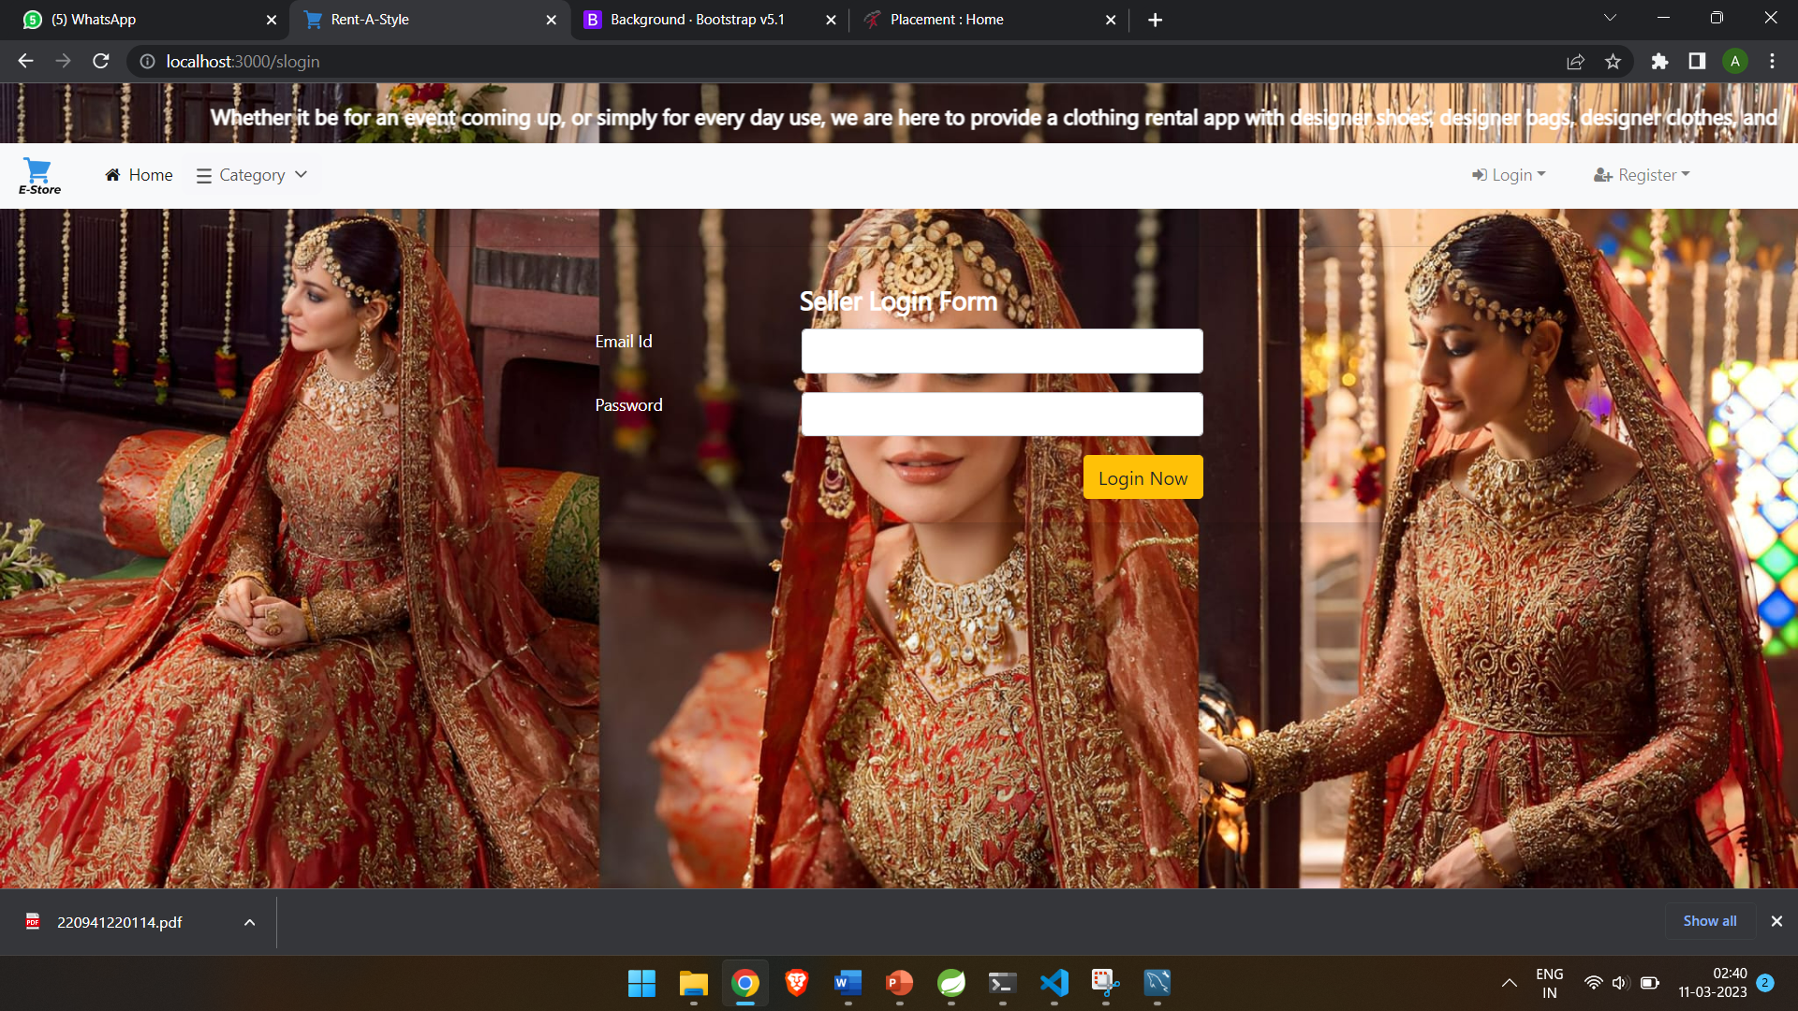
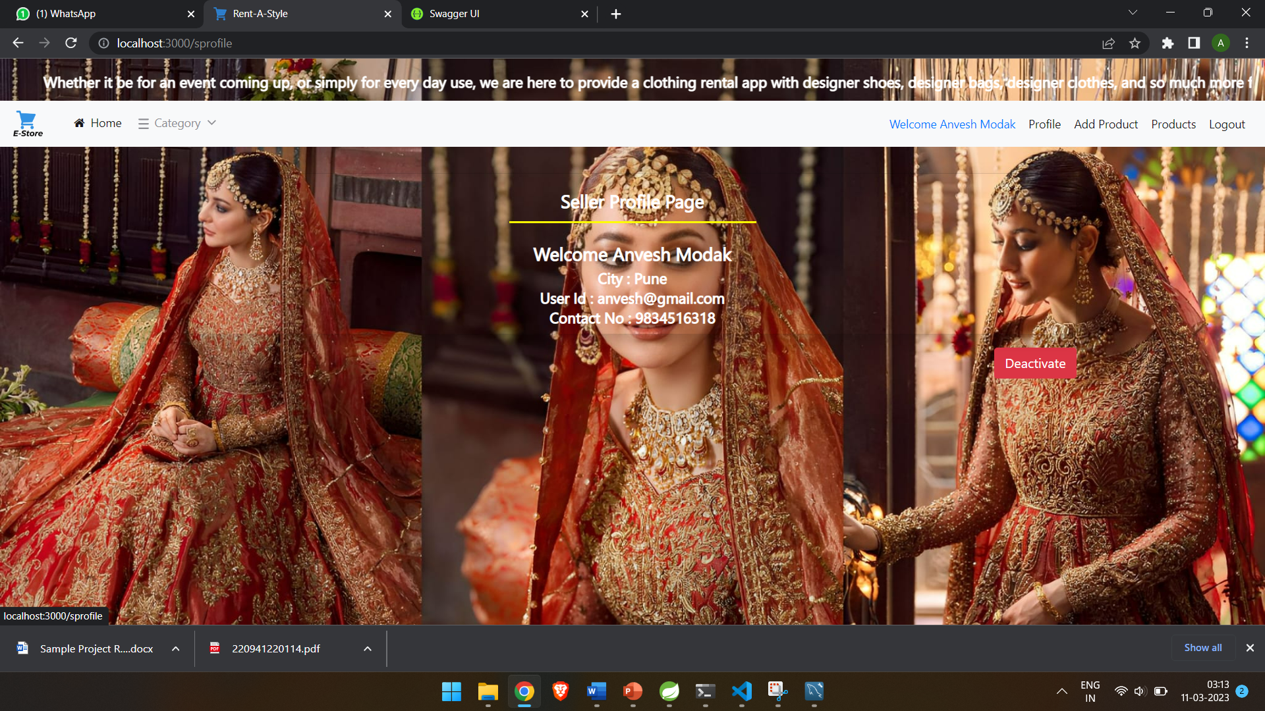
5.1. SELLER

Slide 34
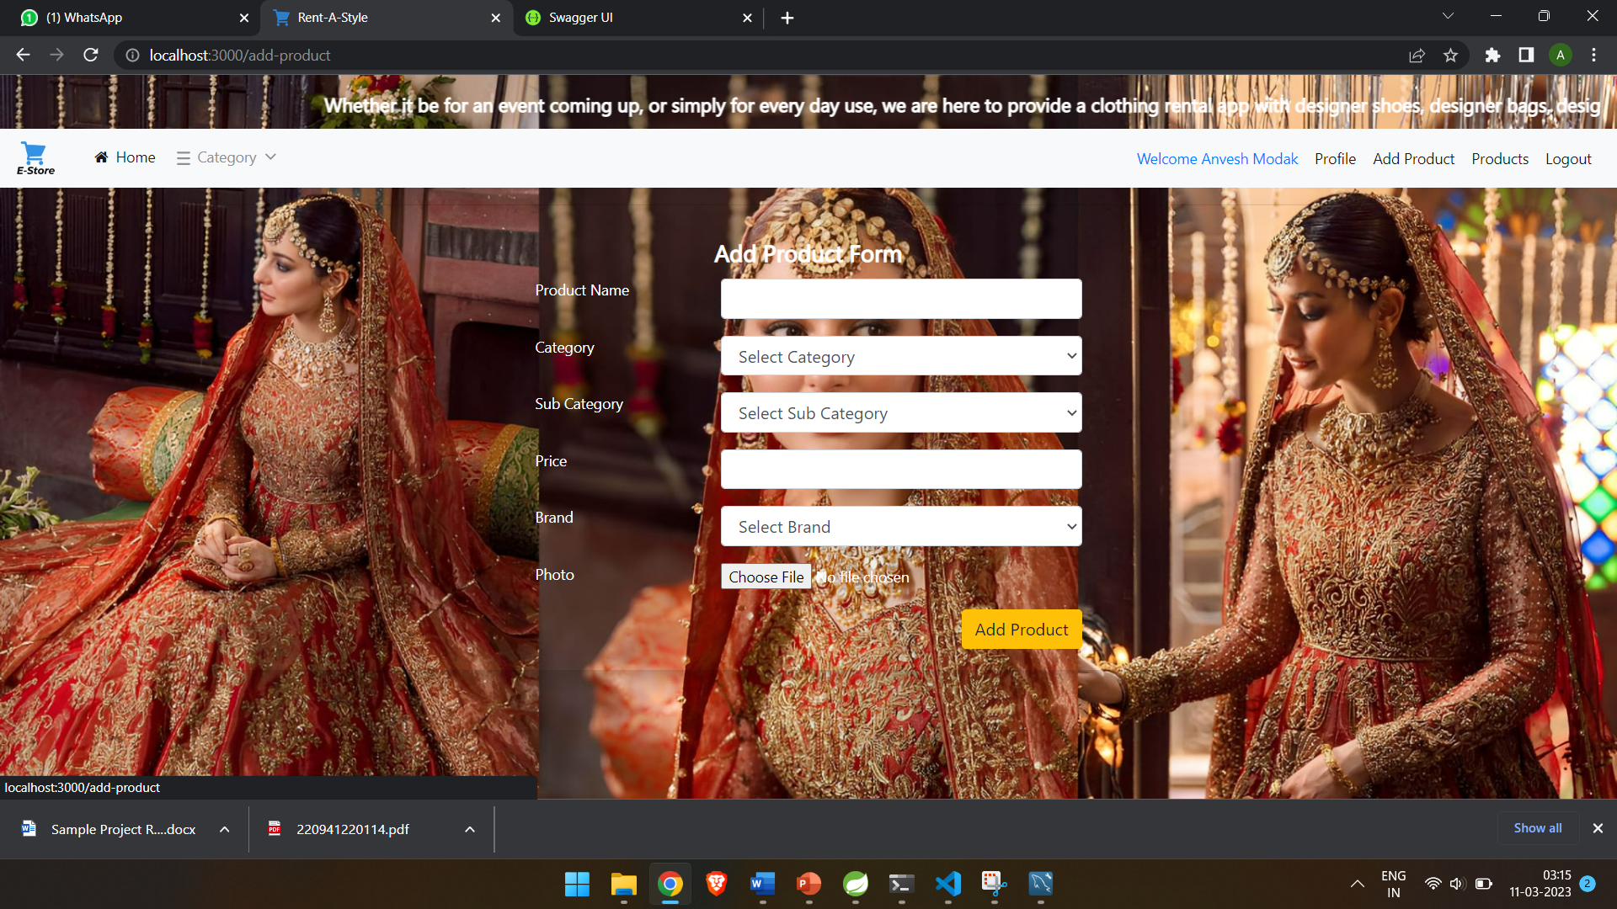
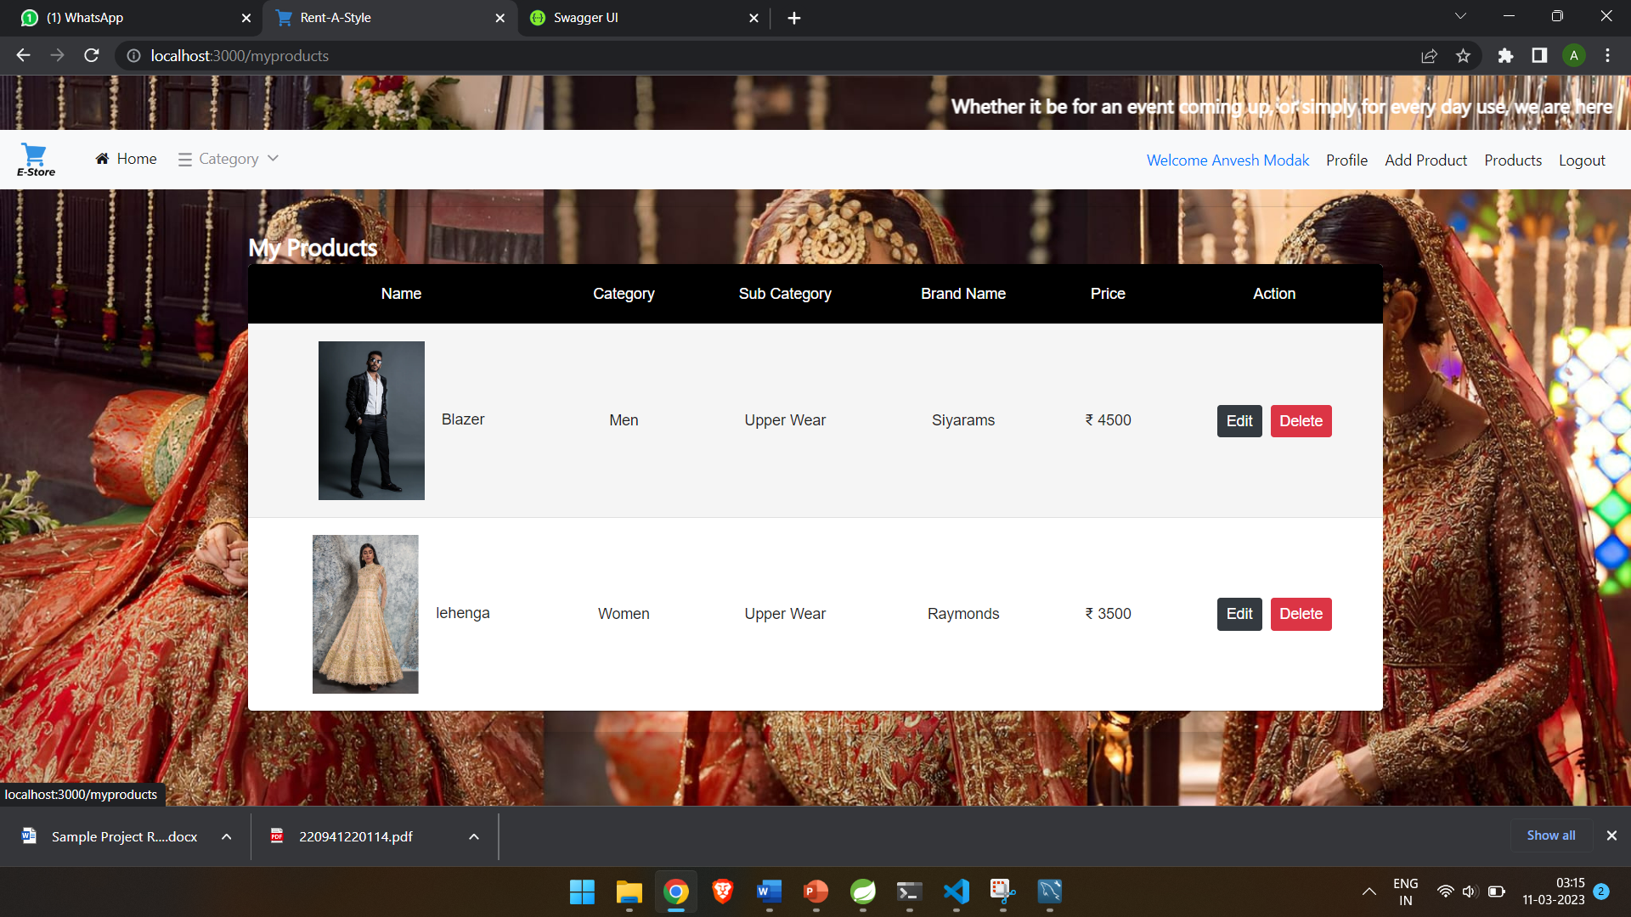
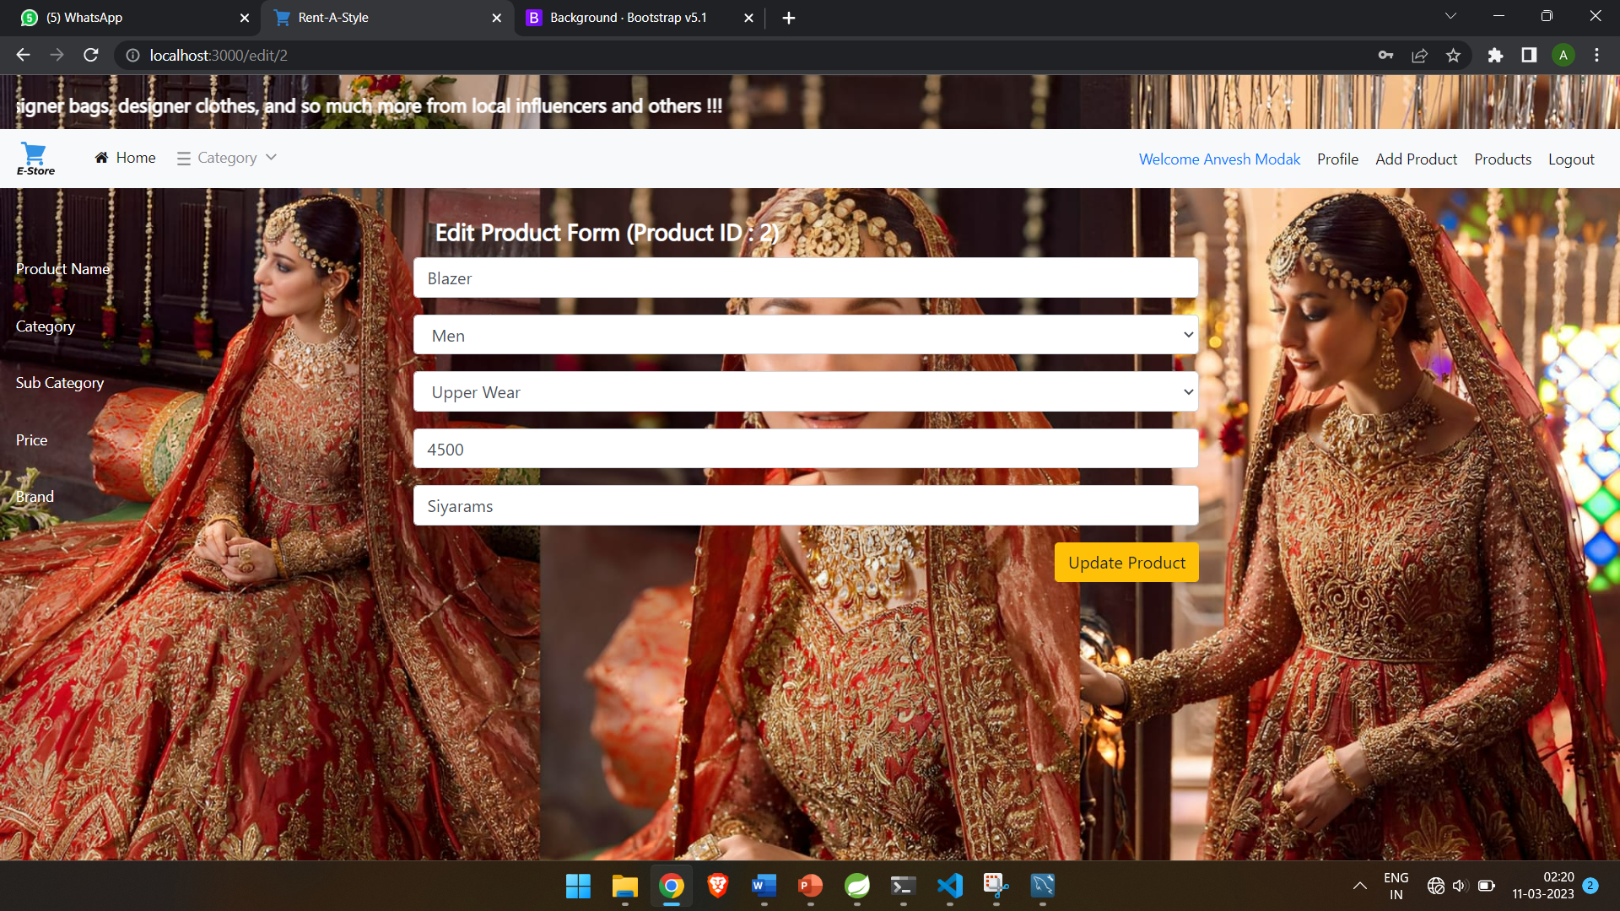

Slide 35

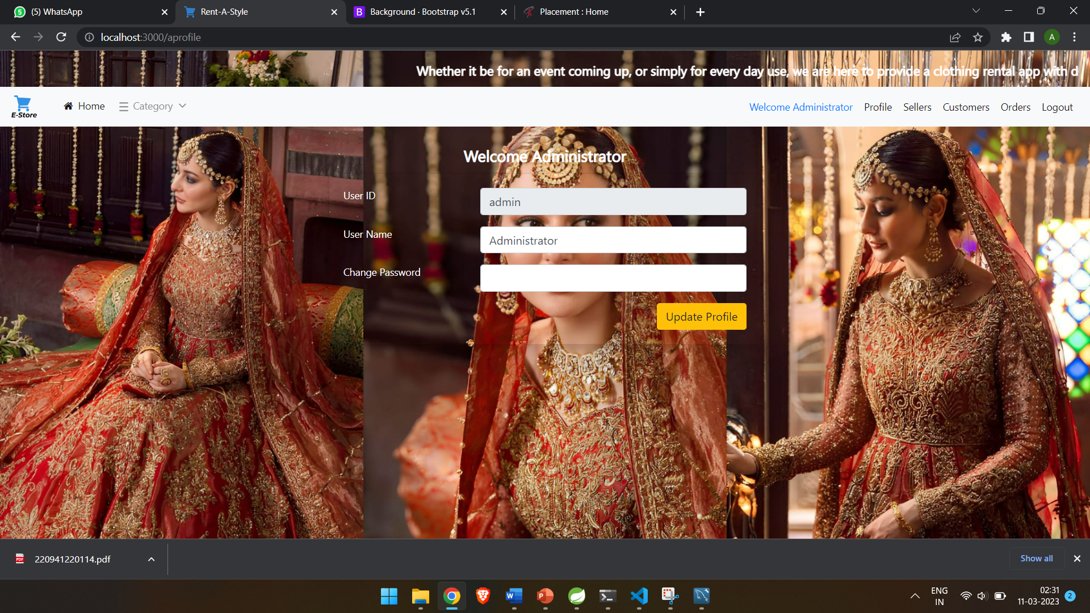
5.1. ADMIN

Slide 36
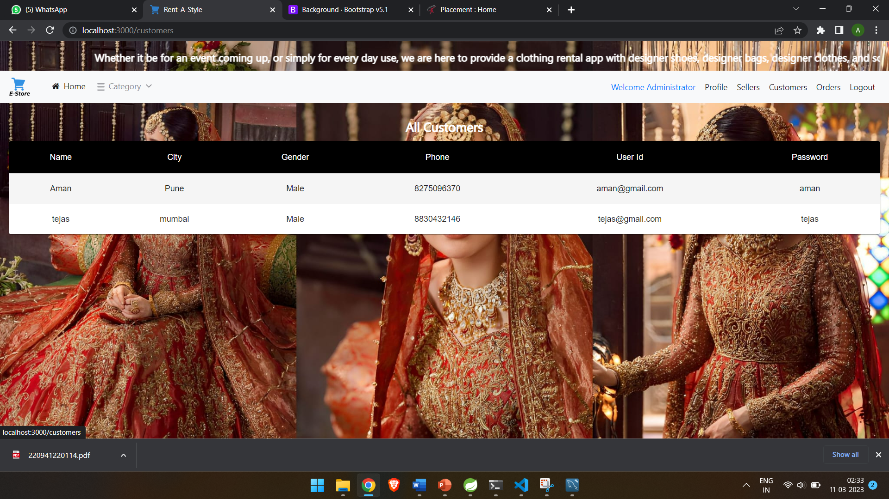
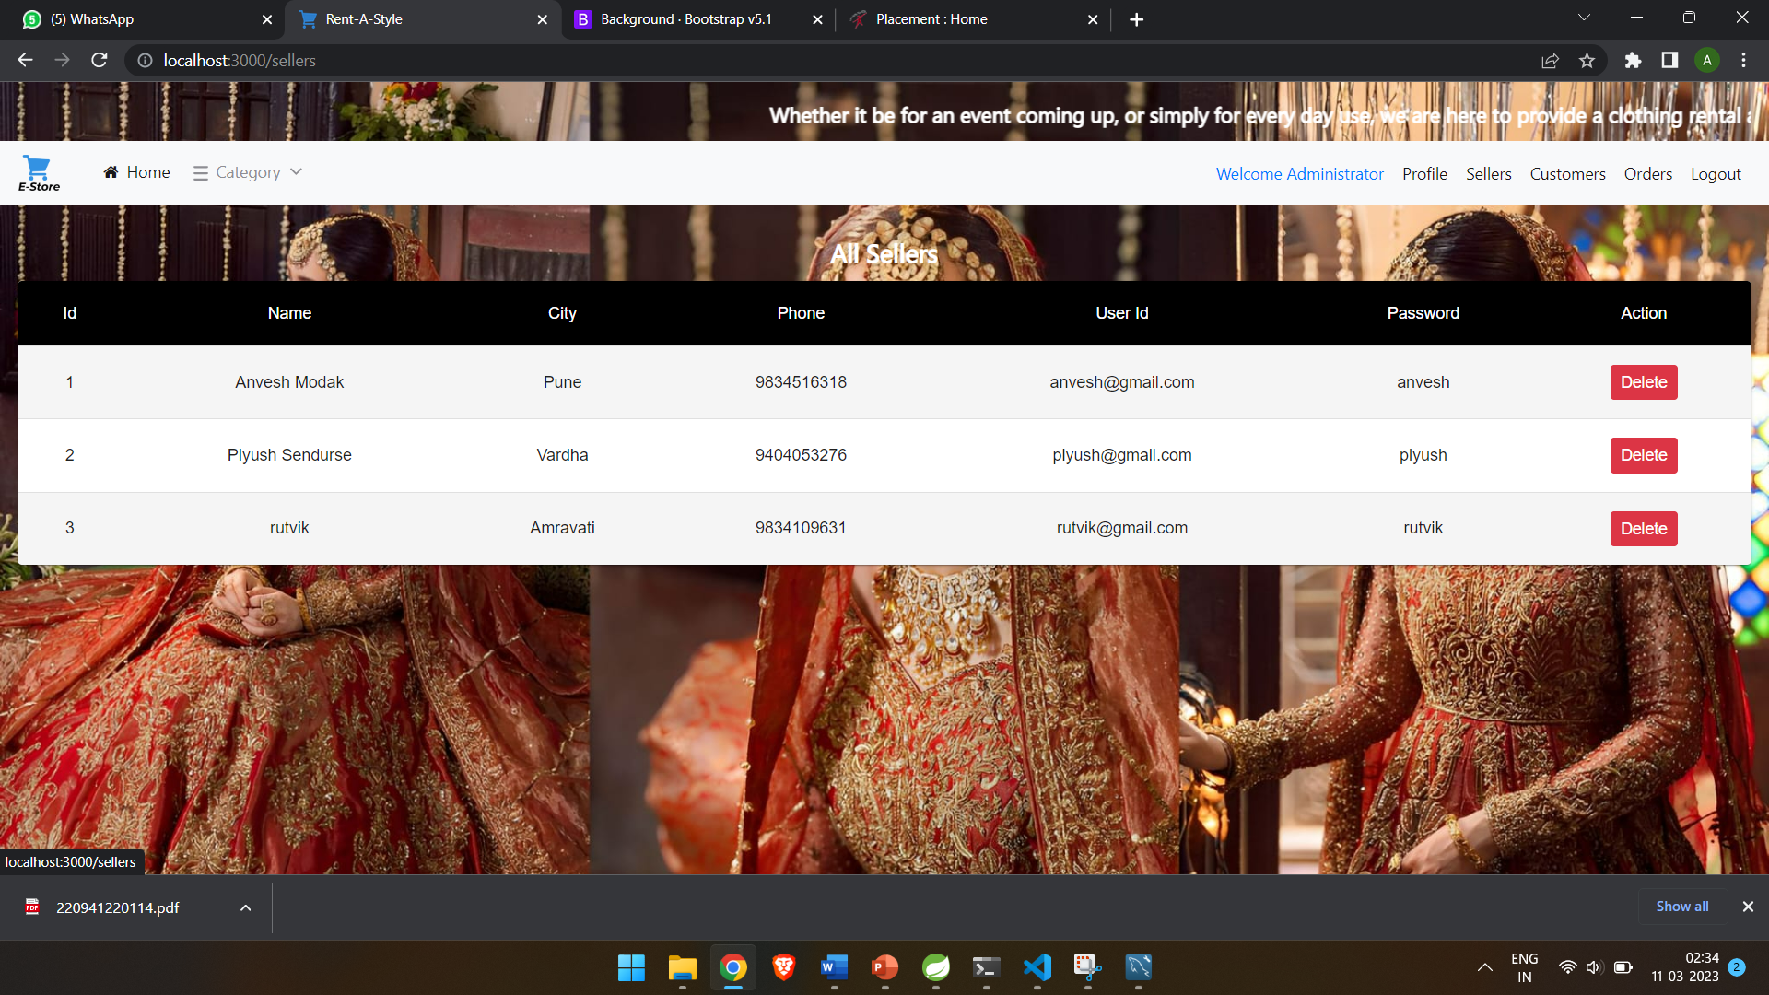
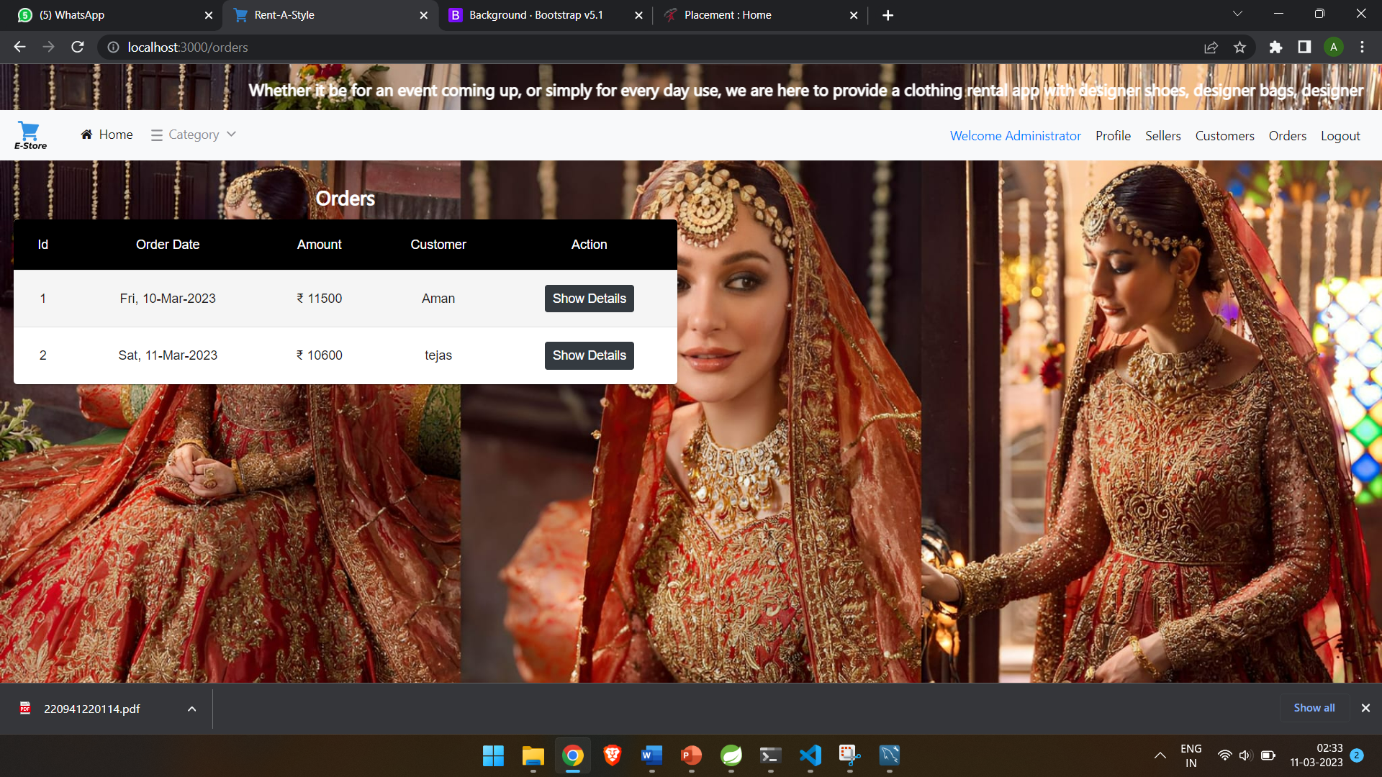

Slide 37
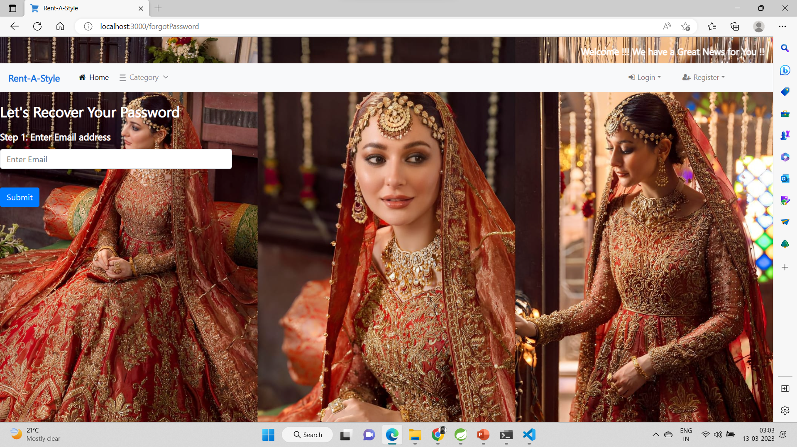
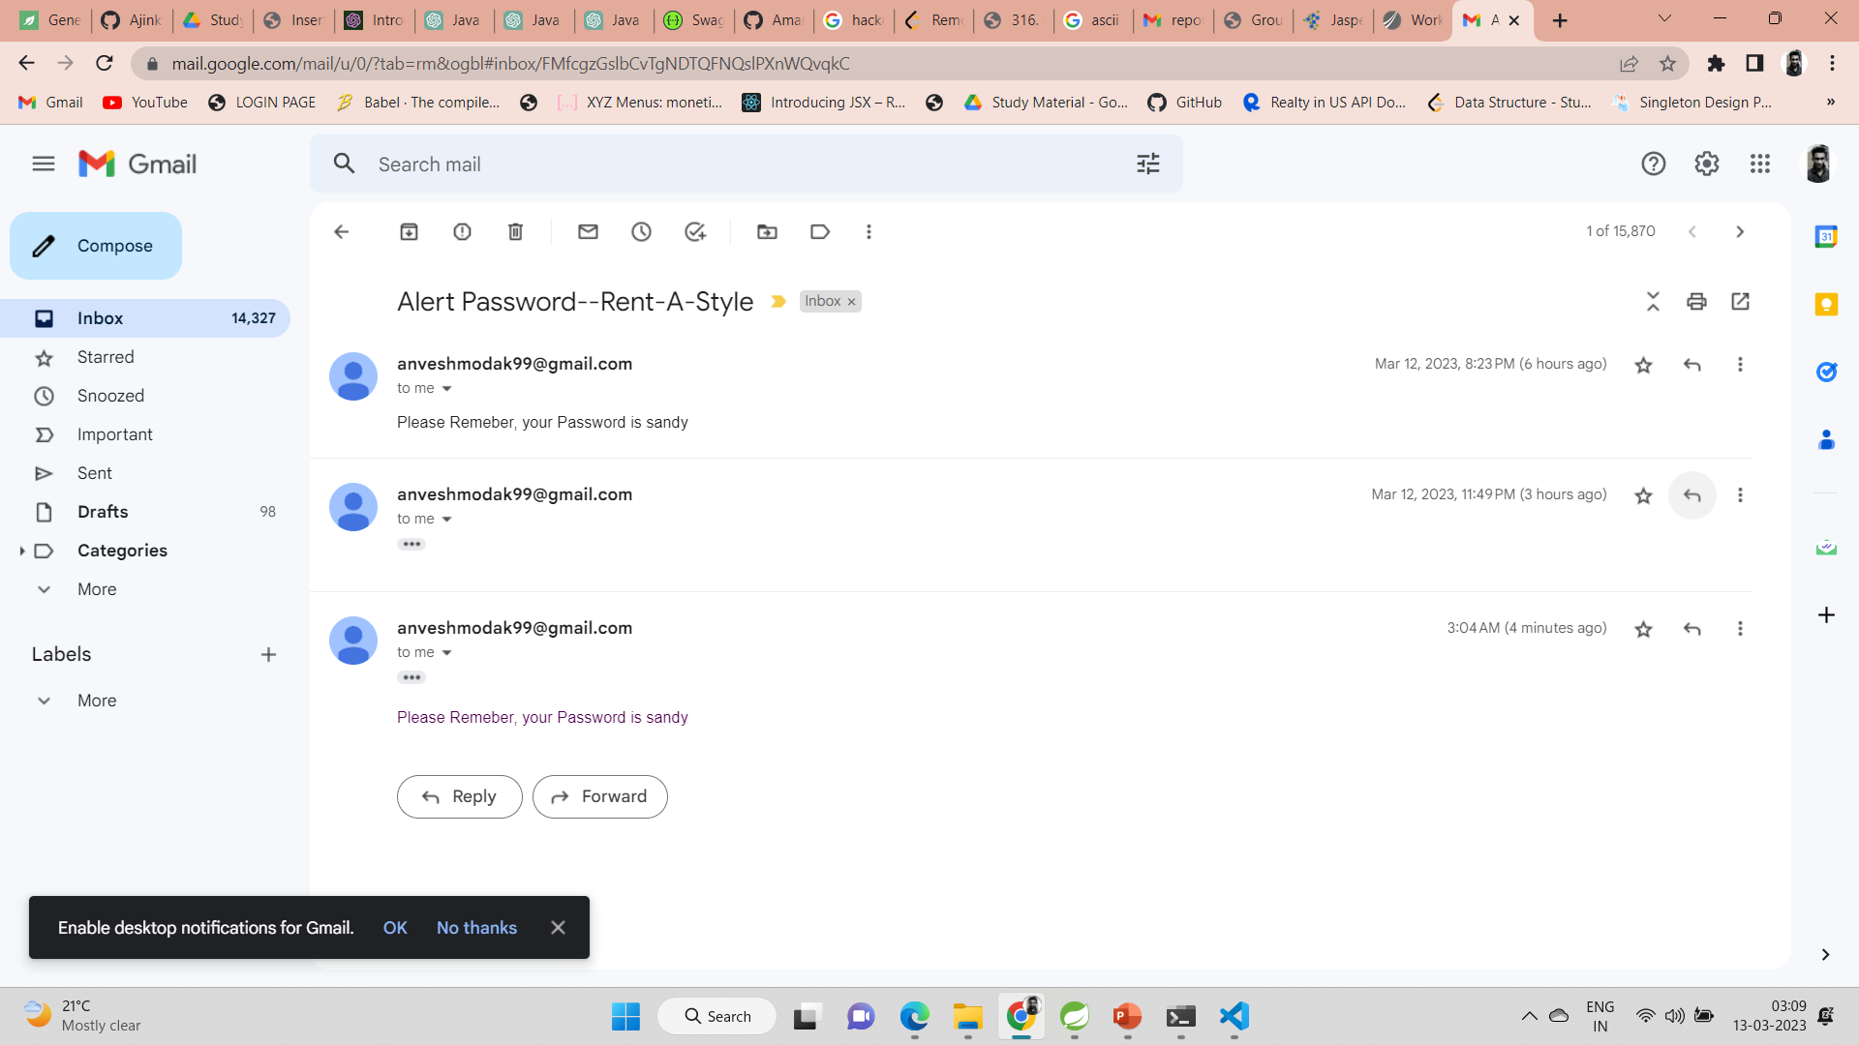
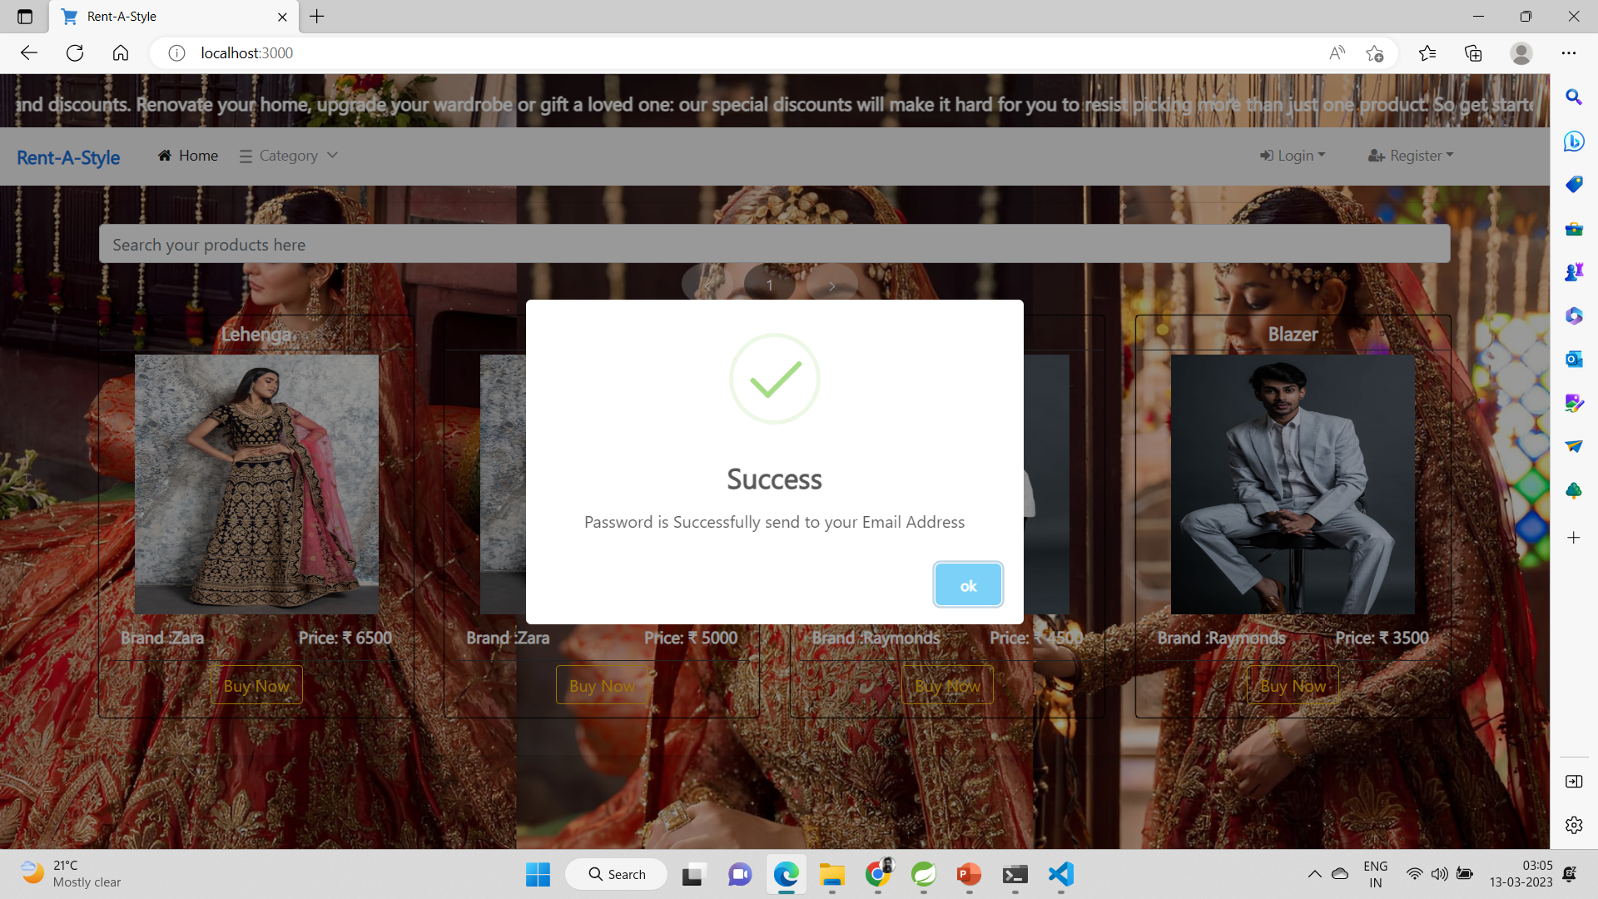

Slide 38
6. TESTING
One of the main purposes of testing is to validate and verify that the system works as intended.
No program or system design is perfect. However, if we implement the system without proper testing, then it may cause problems and lead to a bad user experience.
Testing and checking outcomes of each test gives us the best chance to detect and correct errors before the system is implemented in a production environment.
In the course of our project, we made an effort to manually test each component.
In all cases, we obtained the desired results as demonstrated below.

Slide 39
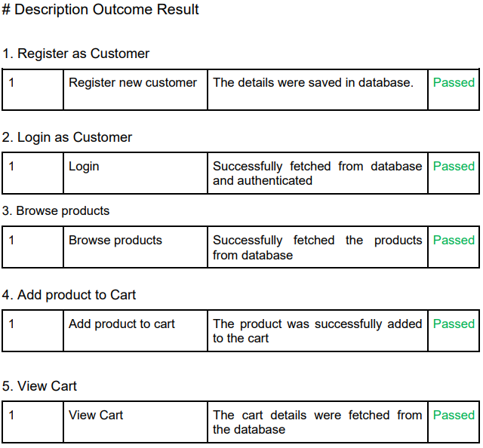
A. CUSTOMER FEATURES TEST

Slide 40
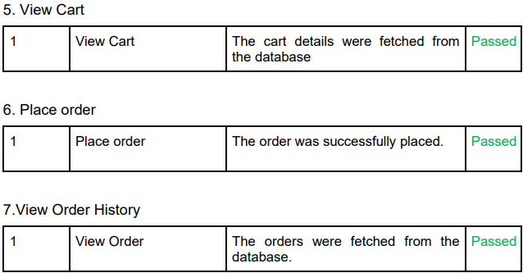
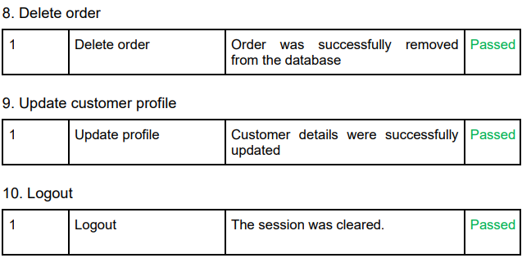

Slide 41
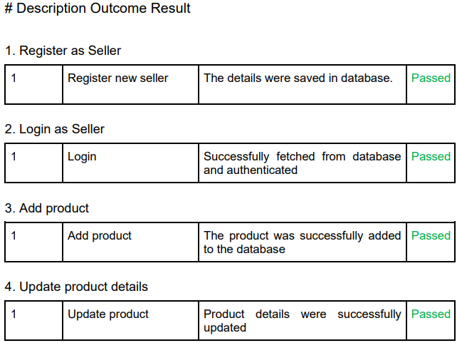
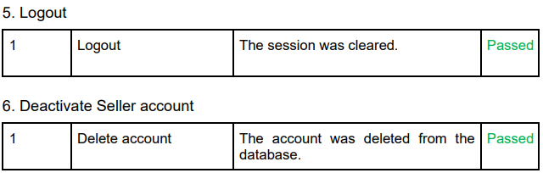
B. SELLER FEATURES TEST

Slide 42
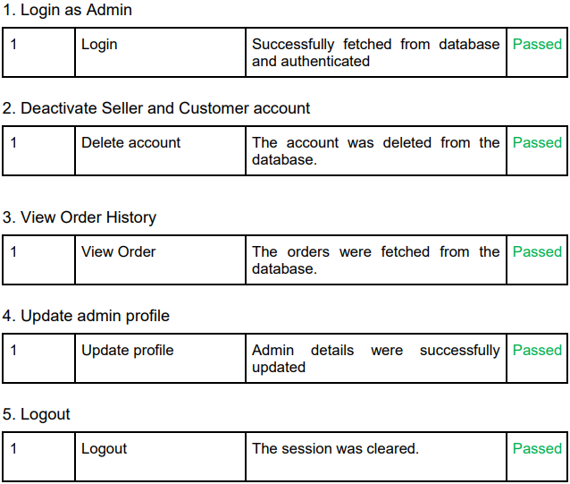
C. ADMIN FEATURES TEST

Slide 43
7. CONCLUSION
“E-Store”, is an online shopping application, developed by our project team to simplify the online sale and purchase of products.
We tried using the latest technologies that are cross-platform and robust.Each and every software we used was open-source in nature, which keeps the cost of production at a minimum.
We were also meticulous about the user experience aspect of our application so that navigating our website is an easy and seamless experience.
In conclusion, “E-Store” as an application would definitely be a good choice for any product trading business that wishes to enter the online market.
We are confident that the numerous features and visually appealing look of the application will certainly give a big boost to the business.

Slide 44
8. FUTURE SCOPE
Using whatever we have learnt over the duration of this course, we tried to make our project as user-friendly and gave it as many features as possible in the limited time allotted for the project work.
That said, there are certainly more features that can be added to our application. Some of those are mentioned below:
Product details can be viewed by hovering on the product.
2. Wish list can be implemented.
3. Customers can add reviews and feedbacks.
4. Additional payment means can be added other than cards.
5. After a confirmed purchase, an email with the invoice of the orders can be sent to the customer.
6. In case the user forgets the password, a “reset password” functionality can be added.
7. An order conformation notification/mail will be sent to the seller.

